Slide 1
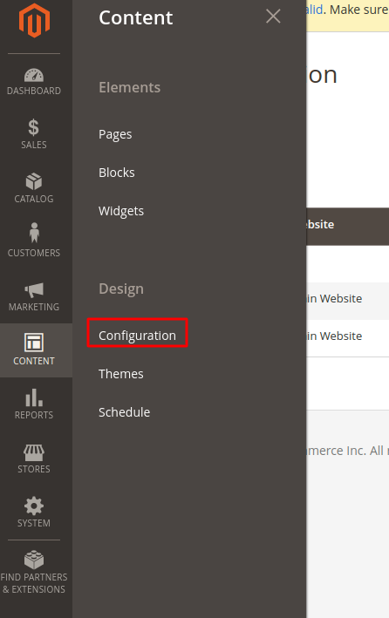

Admin Changes for Custom theme

Slide 2

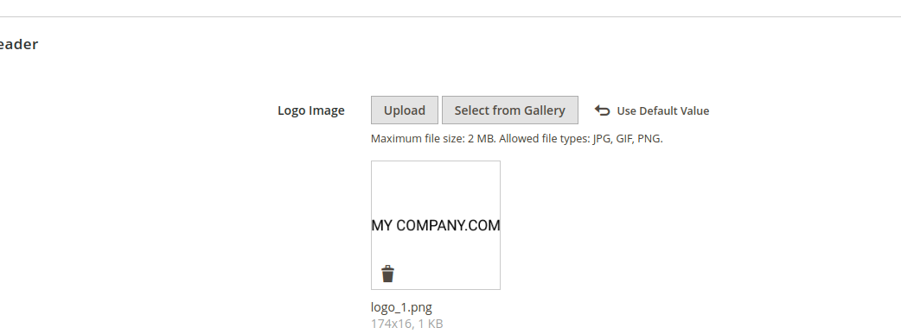

Slide 3
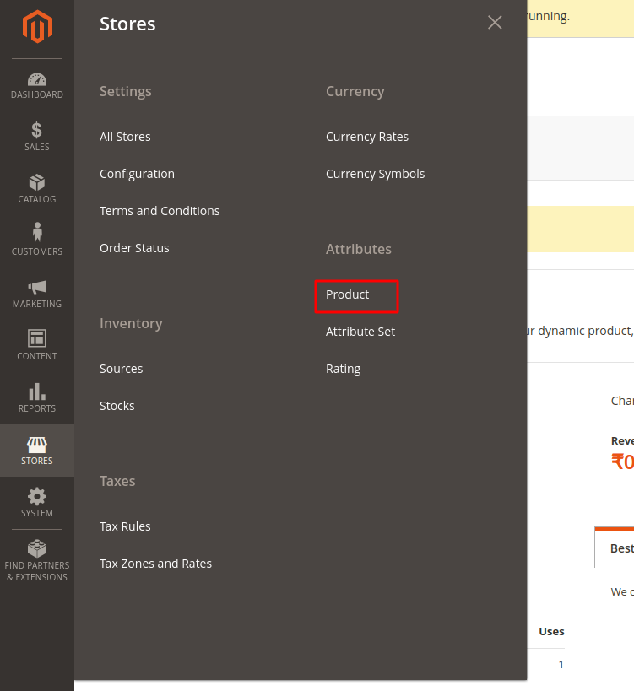
To create product
Goto -> Catalog > Product create new Product fill proper details
Now create attribute for product tabs

Slide 4



Slide 5
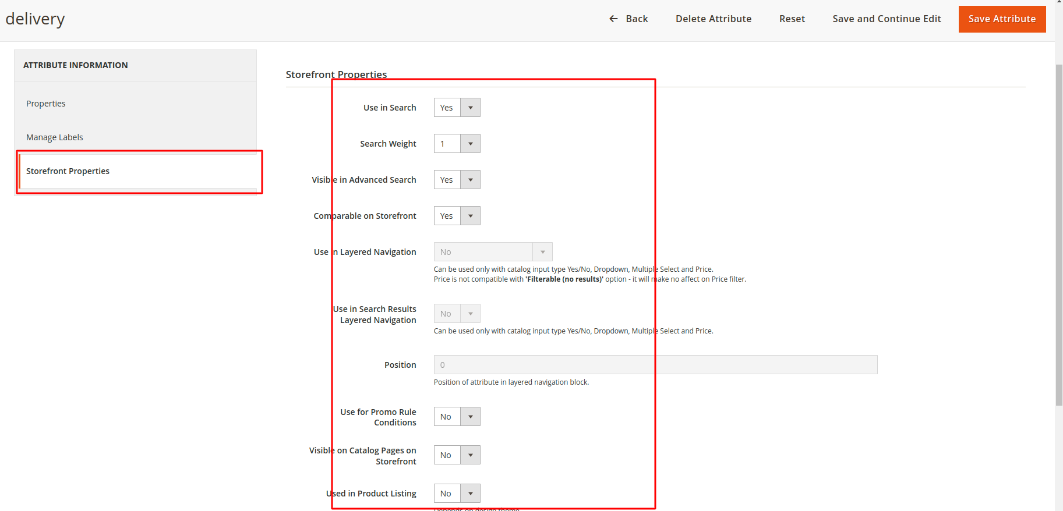

Slide 6

For Fit attribite

Slide 7
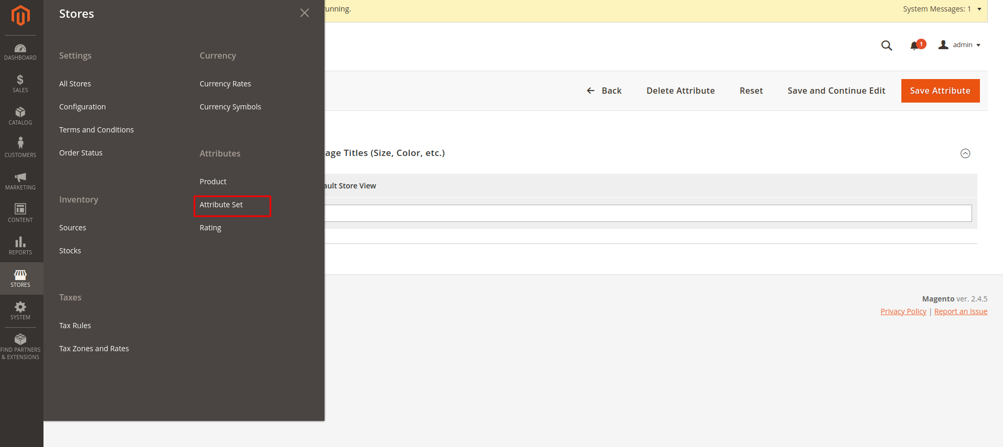
Now go to below steps to assign attribute set

Slide 8
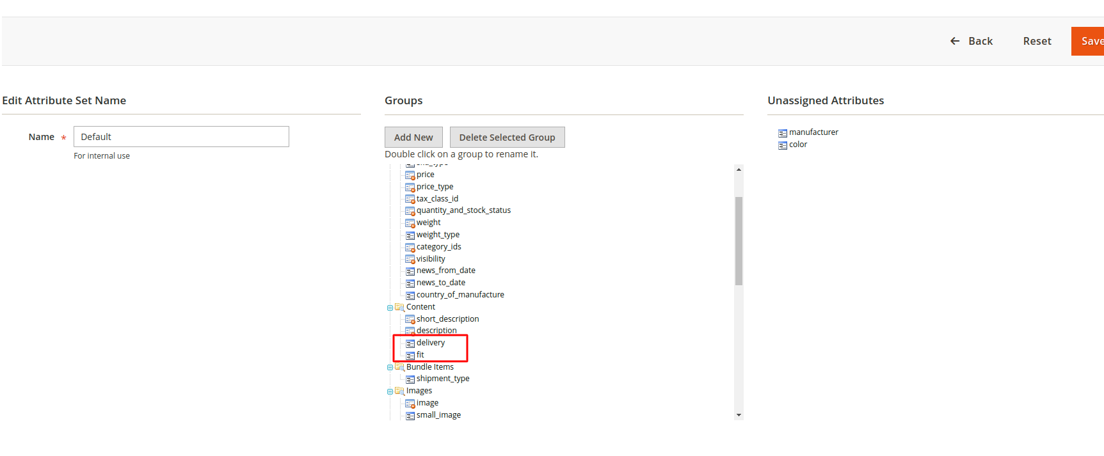
Click on default and drag and drop to below mentioned position

Slide 9
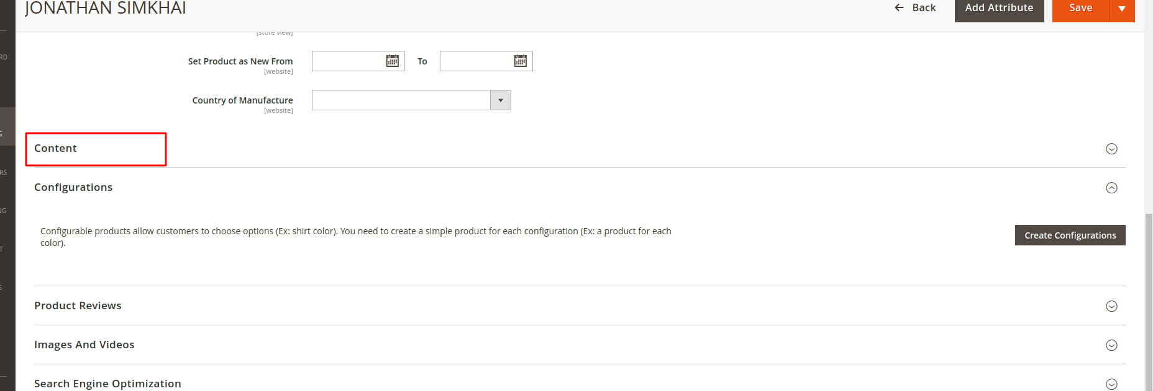
Now goto product and go to content tab fill all details which are require

Slide 10

For image upload to product

Slide 11
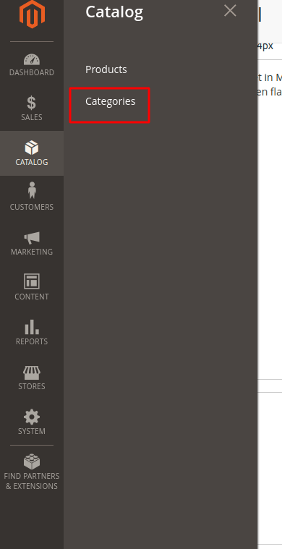
For Menu please create catogories

